Slide 1


Case Study 3: Energy Efficiency in Smart Buildings
AI-Powered Solutions for Sustainable Energy Management

Slide 2
TEAM
ELAKKIYA. K (Team Leader-S4F_CP_Team_11939)
SHYAMA MALIKA. P (Team Member-S4F_CP_Team_11939)
VENGATESWARI. S (Team Member-S4F_CP_Team_11939)
YUVASHREE. S (Team Member-S4F_CP_Team_11939)

Slide 3
Content
Abstract
Problem Statement
Objective
Data Collection and Preparation
Proposed Solution (Methodology)
Model Performance Evaluation
Screenshots / Demonstration (video)
Future Scope
Conclusion
Notes:
Abstract
Problem Statement (Clearly define the challenge)
Objective (State your project's goal)
Background and Research (Discuss existing solutions, trends, and gaps)
Data Collection and Preparation (Focus on data sources, cleaning, and augmentation)
Proposed Solution (Methodology)
Model Architecture (e.g., CNN, U-Net, YOLOv5)
Key Techniques (e.g., Transfer Learning, Image Augmentation)
Model Performance Evaluation
Metrics (Accuracy, Precision, Recall, IoU, etc.)
Graphs (Confusion Matrix, ROC Curve, etc.)
Screenshots / Demonstration (Visual proof of system functionality)
Future Scope (Improvements, scalability, and integration ideas)
Conclusion (Summarize results and impact)
Q&A Session

Slide 4
Abstract
Energy consumption in buildings accounts for nearly 40% of global energy use, making energy efficiency a critical component of sustainability efforts. Smart buildings leverage AI-powered systems to analyze energy consumption patterns, optimize HVAC (heating, ventilation, and air conditioning) operations, and provide actionable recommendations to reduce energy usage. This case study explores the implementation of an AI-based energy management system in commercial buildings, demonstrating its impact on reducing energy waste and operational costs. The study also discusses data collection methods, model development, performance evaluation, and potential future enhancements to further improve energy efficiency and support net-zero energy goals.

Slide 5
Problem Statement
Buildings account for nearly 40% of global energy consumption.
High energy consumption in commercial buildings
Need for sustainability and efficiency improvements
AI can optimize energy use and reduce waste

Slide 6
Data Collection and Preparation
Dataset Includes:
Building energy usage data
Occupancy data
Weather conditions (temperature, humidity, etc.)
Historical energy consumption trends

Slide 7
Objective
Key Goals:
Analyze energy consumption patterns in buildings
Optimize heating, cooling, and ventilation systems
Provide AI-driven recommendations to reduce energy usage

Slide 8
Proposed Solution (Methodology)
AI-Based Energy Optimization System:
Data Preprocessing & Cleaning
Feature Engineering (Identifying Key Variables)
Model Selection (Regression, Neural Networks, etc.)
Training and Evaluation
Deployment for Real-Time Monitoring & Optimization

Slide 9
Model Performance Evaluation
Metrics for Evaluating the AI Model:
Mean Absolute Error (MAE)
Root Mean Square Error (RMSE)
Accuracy in predicting energy consumption patterns
Effectiveness in optimizing HVAC systems

Slide 10
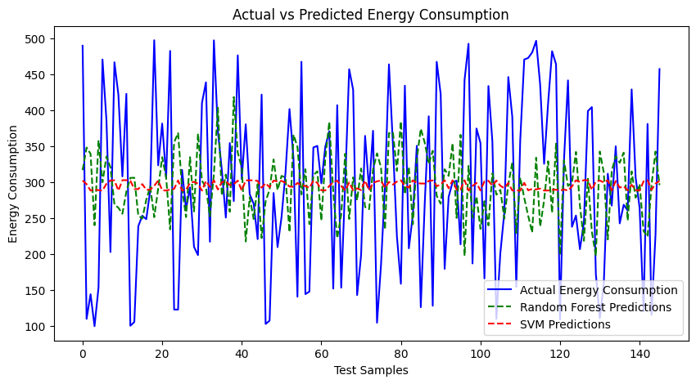
Screenshots / Demonstration (video)
Github Link : https://github.com/Elakkiya2106/CASE-STUDY-3-ENERGY-EFFICIENCY_IN_SMART_BUILDINGGS

Slide 11
Future Scope
Further Enhancements:
Integration with IoT sensors for real-time data collection
AI-driven demand-response energy management
Incorporation of renewable energy sources for sustainability
AI-powered predictive maintenance for HVAC systems

Slide 12
How can AI be used to identify inefficiencies in energy consumption in smart buildings?
AI can analyze energy usage patterns, detect anomalies, and identify wastage in real time.
Machine learning models can predict peak energy usage times and optimize HVAC operations accordingly.
AI-driven automation can adjust lighting, heating, and cooling based on occupancy and external factors.

Slide 13
2. Build a model to predict the energy consumption of the building based on occupancy and weather data.
Use regression models (e.g., Linear Regression, Random Forest, or Neural Networks) trained on historical occupancy and weather data.
Input features: Temperature, humidity, number of occupants, time of day, historical energy consumption.
Output: Predicted energy consumption for a given time period.

Slide 14
3. Suggest additional features that could be incorporated into the model to improve its accuracy.
Real-time IoT sensor data (e.g., CO2 levels, motion sensors, appliance usage).
Building insulation characteristics.
Dynamic pricing of electricity to optimize cost-effective energy use.
Seasonal variations in energy consumption patterns.

Slide 15
4. What steps can building managers take based on the model's predictions to reduce energy consumption?
Implement AI-driven HVAC control to adjust heating and cooling dynamically.
Schedule maintenance based on predictive analytics to prevent energy inefficiencies.
Use smart lighting systems that adjust based on occupancy.
Encourage employees or tenants to adopt energy-saving practices based on data insights.

Slide 16
5. How can AI-driven solutions contribute to achieving net-zero energy buildings?
AI can optimize the integration of renewable energy sources such as solar and wind.
Intelligent demand-response systems can balance energy loads efficiently.
AI can improve energy storage management, ensuring maximum efficiency of stored energy.
Predictive maintenance can extend the life of energy-efficient equipment and prevent inefficiencies.

Slide 17
Conclusion
Key Takeaways:
AI can significantly improve energy efficiency in smart buildings
Predictive models help optimize energy usage
Future advancements will further reduce energy waste and costs

